Slide 1

Smart Quiz Platform: Admin-Controlled MCQ System in Python
Presented by :
P. Santhosh Kumar
Batch No : 504

Slide 2
About Me
Background:
I pursuing my bachelor of Technology in CSE(AI-ML) in Sandip University.
Why you want to learn Data Science:
I want to become an Quant engineer for that data science is base.
Any work experience:
So, far I have no experience
LinkedIn : www.linkedin.com/in/puppala-santhosh-kumar
GitHub

Slide 3
Agenda
Business problem
Introduction
Objective of the Project
Problem Statement
Concepts Used
Working of the System
Working Of Methods
Execution of Code
Conclusion
Q&A Slide

Slide 4
Business problem:
Quizzes and assessments are often conducted manually or with basic,
unstructured tools
Lack of proper security in existing systems
Difficulty in managing and organizing multiple-choice questions
Challenges in updating quiz content efficiently
Maintaining fairness in assessments is problematic
No clear separation between admin and user roles
Risk of unauthorized access or modification of quiz data
Students lack a personalized and consistent quiz experience
No proper system to track student performance
Absence of a centralized system for quiz management
Overall process is time-consuming, error-prone, and inefficient

Slide 5
Introduction
Quizzes and assessments are essential for evaluating knowledge and improving learning
Traditional methods are manual, unorganized, and time-consuming
Lack of proper security and structured systems
Difficulty in managing questions and users efficiently
Need for a reliable and automated quiz management system
Project title: “Quiz Management System with Admin Control and User Authentication using Python”
Introduces role-based access for Admin and Users
Admin can add, view, and delete multiple-choice questions
Users can securely log in and attempt quizzes
System automatically evaluates answers and displays scores
Reduces manual effort and improves accuracy
Built using Python concepts: file handling, exception handling, and object-oriented programming
Demonstrates practical application of programming skills

Slide 6
Objectives
To develop a Quiz Management System using Python for conducting MCQ-based quizzes.
To implement a secure login system with separate roles for Admin and Users.
To allow the Admin to add, view, and delete quiz questions efficiently.
To enable Users to attempt quizzes and receive automatic evaluation and scores.
To use file handling for storing and retrieving user and quiz data.
To apply exception handling to manage invalid inputs and errors effectively.
To design the system using object-oriented programming (OOP) principles for better structure and reusability.
To reduce manual effort and create a simple, efficient, and user-friendly quiz system.

Slide 7
Problem Statement
Traditional quiz systems are often manual, unorganized, and lack proper security, making it difficult to manage questions and users efficiently. There is no clear role-based access, which can lead to unauthorized modifications and errors in quiz data.
This project aims to develop a Quiz Management System using Python that provides secure login, admin control for managing questions, and an automated system for conducting and evaluating MCQ-based quizzes efficiently.

Slide 8
Concepts Used
Data Types – Used to store different types of data like strings, numbers, and lists (e.g., questions, options, scores).
Operators – Used to perform calculations and comparisons, such as checking answers and calculating scores.
Conditional Statements (if-elif-else) – Used to make decisions like validating login and checking correct answers.
Loops (for, while) – Used to repeat tasks like displaying menu and iterating through questions.
Functions – Used to organize code into reusable blocks for tasks like login, quiz, and admin operations.
File Handling – Used to store and retrieve data such as user credentials and quiz questions from files.
Exception Handling – Used to handle errors like invalid input or missing files without crashing the program.
Object-Oriented Programming (OOP) – Used to create classes (like Question/User) for better structure and reusability of code.

Slide 9
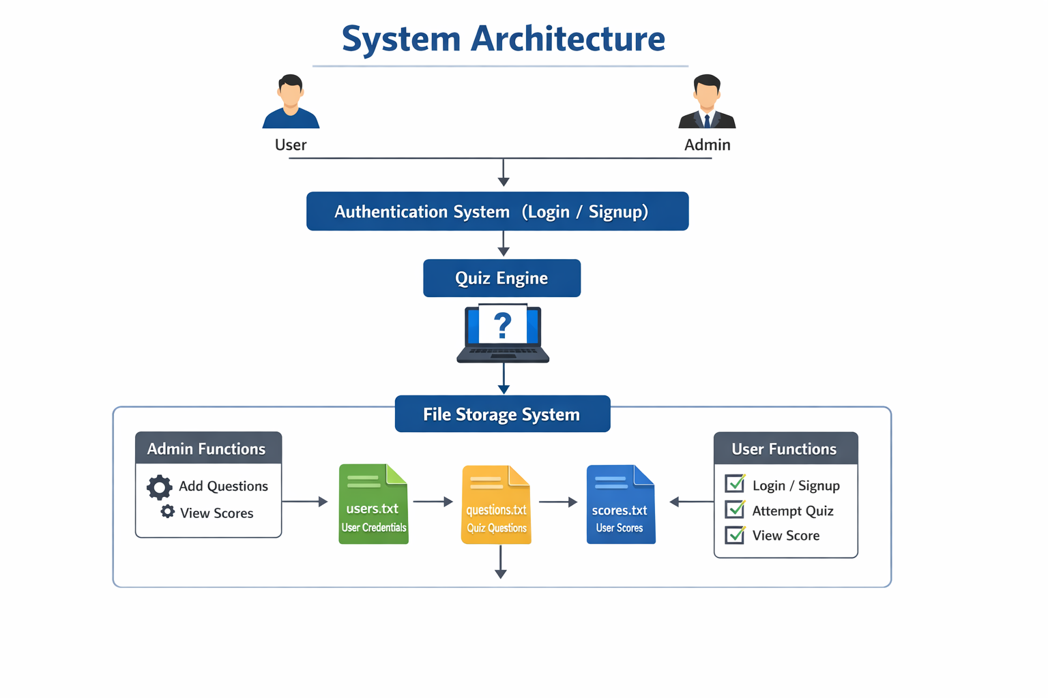
System architecture:
The system has two roles: User and Admin, both using an authentication system with users.txt
The quiz engine handles questions, answers, and score calculation
Data is stored using files: questions.txt (questions) and scores.txt (results)
Admin can add questions and view scores, while users can take quizzes and see performance
The architecture ensures organized data management and smooth functioning

Slide 10
Working of the Program
The program starts with main(), showing options: User, Admin, or Exit
User flow:
Signup/Login using users.txt
After login, user takes quiz from questions.txt
Questions are shuffled and limited (e.g., 5 questions)
Answers are checked and score is calculated
Final score is displayed and saved in scores.txt
Admin flow:
Login using a password
Can add new questions to questions.txt
Can view scores from scores.txt (sorted leaderboard)
The program runs in a loop until Exit is selected

Slide 11

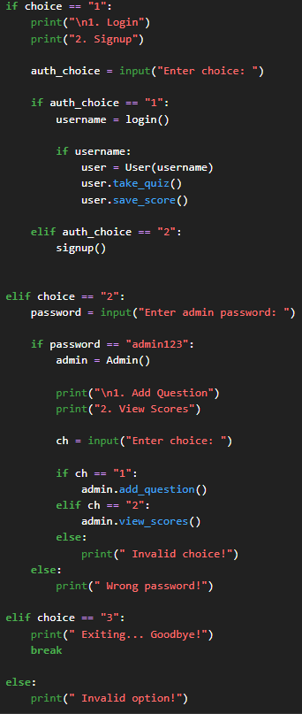
I used a while loop in this part of the code, which allows the program to keep running until the user stops it.
In this part of the code, I have used conditional statements to control the flow based on conditions.

Slide 12
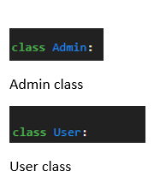

User class: Represents a player who can take the quiz, track their score, and save it.
Admin class: Represents an admin who can add new questions and view user scores.
As this is menu driven code the user can select the option which are given in code while execution
MENU GIVEN IN THE CODE

Slide 13
WORKING OF METHODS
User Selection – The system starts with a menu where the user chooses between Admin login, User login, or Exit.
Authentication Process – The entered username and password are verified using stored data in a file to ensure secure access.
Role-Based Access – Based on login credentials, the system grants access either to Admin features or User features.
Admin Operations – The Admin can add new MCQ questions, view existing questions, and delete questions from the file.
Data Storage – All questions and user details are stored in files, ensuring data persistence for future use.
Quiz Execution – The User can attempt the quiz where questions are displayed one by one with multiple options.
Answer Evaluation – The system checks each answer and calculates the score automatically using conditions and operators.
Result Display – At the end of the quiz, the total score is displayed to the user.
Error Handling – The system handles invalid inputs and file-related errors using exception handling to avoid crashes.

Slide 14
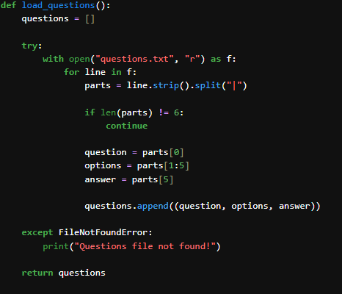
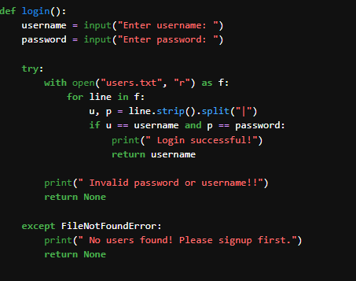
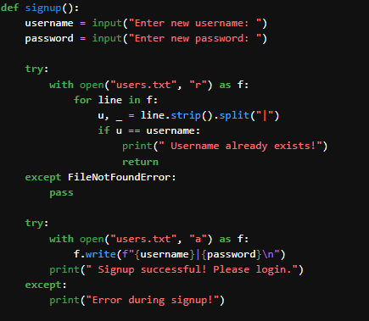
A Python function that reads questions from a text file, splits each line into question, options, and answer, and stores them in a list while handling missing file errors.
Method 1 load questions
A Python function that verifies user login by checking entered credentials against stored data in a file and returns the username if valid, with error handling.
Method 3 login for the user
A Python function that registers a new user by checking for existing usernames in a file and appending new credentials if unique, with error handling.
Method 2 signup

Slide 15
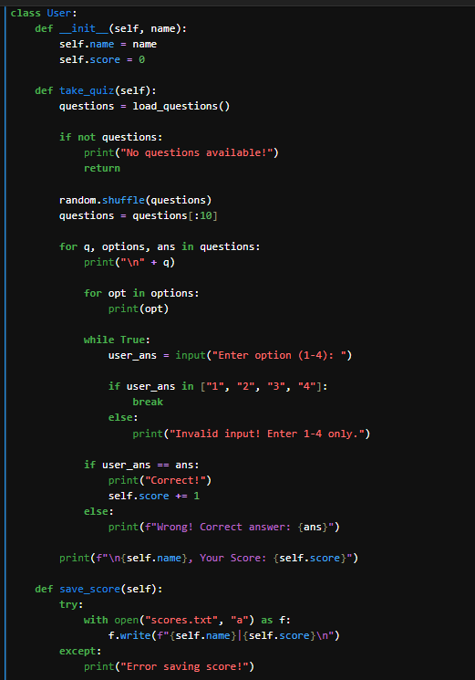
Defines a User class using object-oriented programming (OOP)
The constructor (__init__) initializes:
User name
Score = 0
take_quiz() method:
Loads questions and checks availability
Randomly shuffles questions
Selects a fixed number (e.g., 10 questions)
Displays questions with options
Takes validated input (only 1–4)
Checks answers and updates score
Displays the final score after completing the quiz
save_score() method:
Saves user name and score to scores.txt
Uses file handling with exception handling for safety
Demonstrates key concepts:
OOP (classes & methods)
Loops and conditionals
Input validation
Randomization
File handling

Slide 16
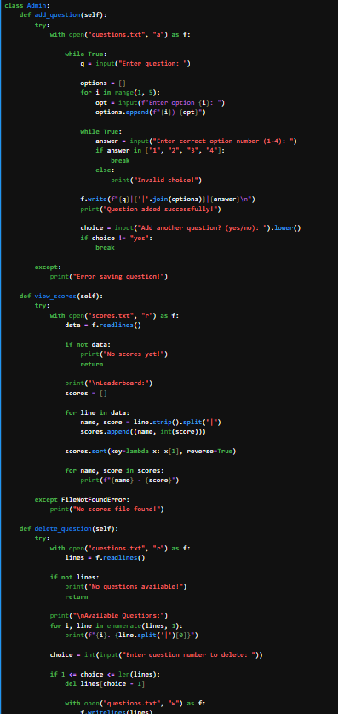
Here is your content in concise bullet points:
Defines an Admin class to manage quiz data
Supports key operations:
Add questions
View scores
Delete questions
add_question() method:
Takes question, 4 options, and correct answer (1–4)
Validates input and formats data
Saves to questions.txt
Allows adding multiple questions in a loop
view_scores() method:
Reads data from scores.txt
Checks if scores exist
Displays a sorted leaderboard (highest to lowest)
delete_question() method:
Displays all questions with numbering
Allows deletion by selecting index
Updates file with remaining questions
Uses important concepts:
File handling
Loops and conditionals
Exception handling
List operations

Slide 17
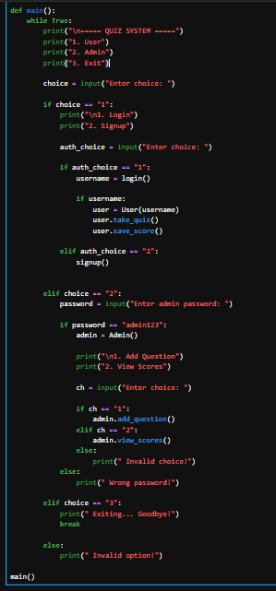
Here is your content in concise bullet points:
main() function acts as the central controller of the application
Runs continuously in a loop until the user selects Exit
Displays menu options:
User mode
Admin mode
Exit
User mode:
Provides login or signup options
After login, creates a User object
Allows user to take quiz and saves score
Admin mode:
Verifies admin password
Allows adding questions or viewing leaderboard
Handles invalid inputs properly and ensures smooth navigation
Acts as the backbone of the system, coordinating all functionalities
The main method of this Quiz project

Slide 18
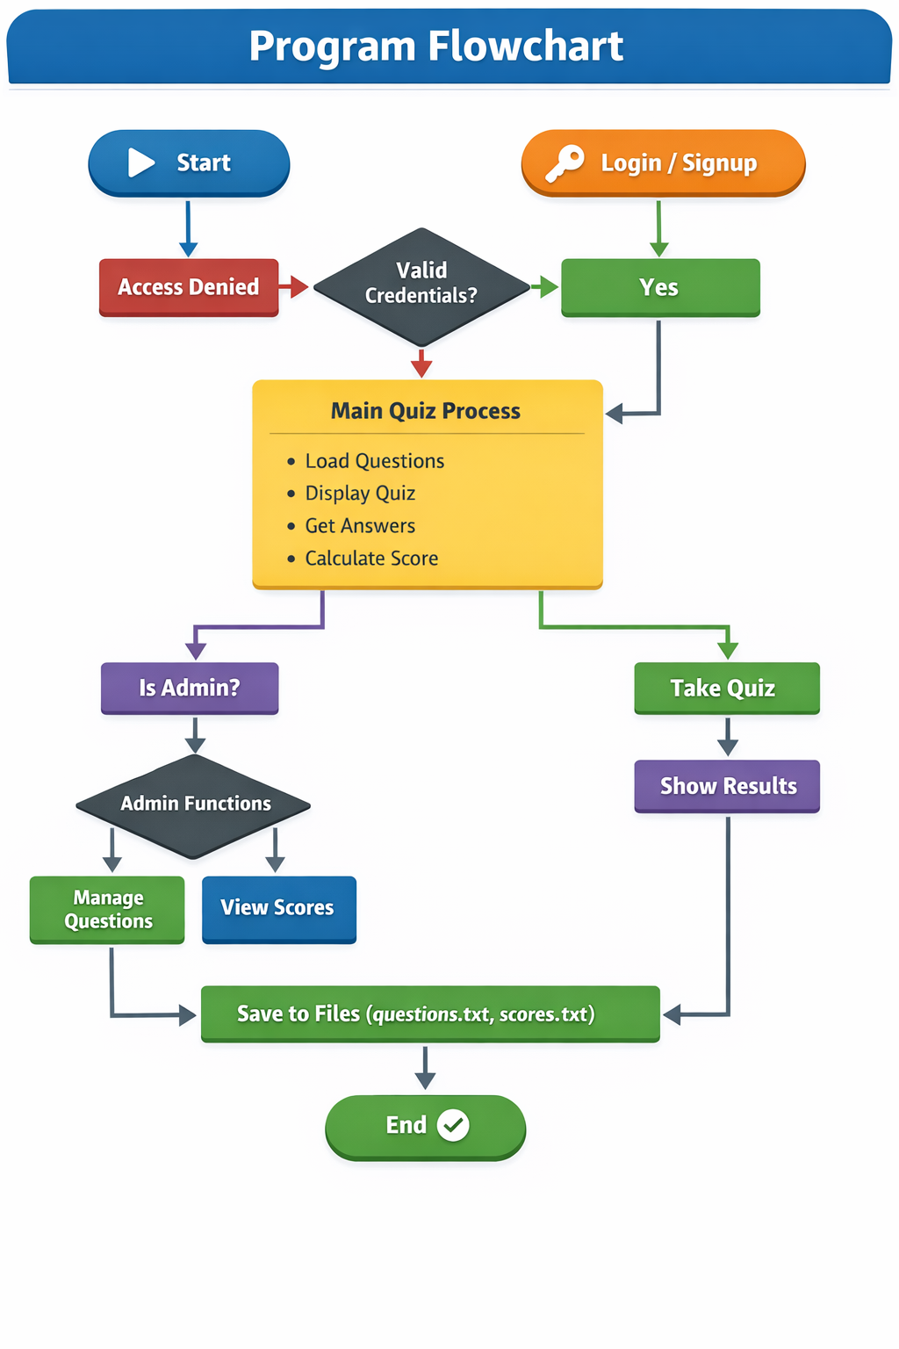

Slide 19
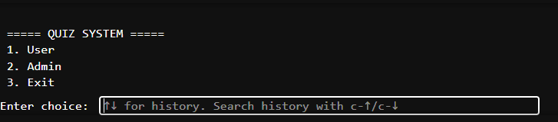
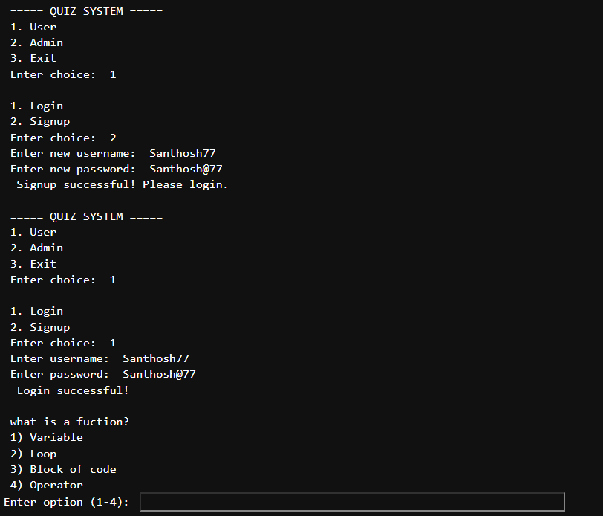
Execution Of The Code
It shows the main menu of the quiz program where the user chooses between User, Admin, or Exit.
The user selects User → Signup, creates a new account, and gets a success message.
Then selects User → Login, enters credentials, and logs in successfully.
After login, the quiz starts and displays a question with options.
The program waits for the user to enter an answer (1–4).

Slide 20
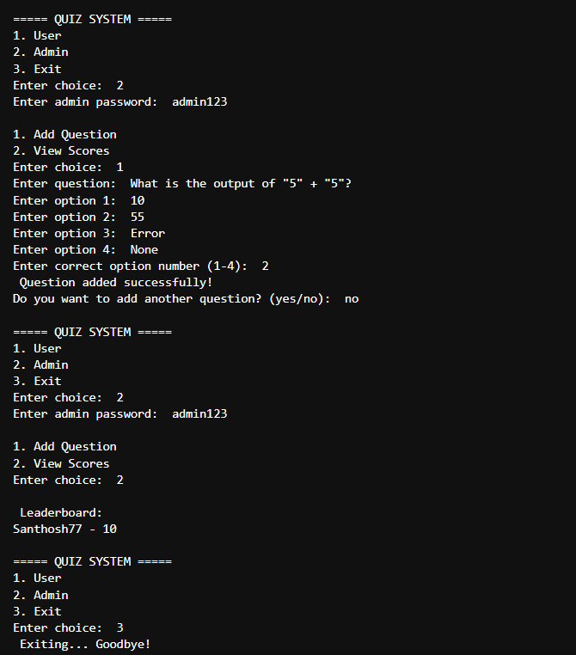
The admin logs in using the correct password and selects Add Question, then enters a question, options, and correct answer, which gets saved successfully.
The admin chooses not to add more questions and returns to the main menu.
Then the admin logs in again and selects View Scores, which displays the leaderboard with user scores.
Finally, the user selects Exit, and the program terminates

Slide 21
Future Enhancements:
• Develop GUI using Tkinter or Web Interface
• Replace text files with database (MySQL / SQLite)
• Add timer-based quiz functionality
• Implement password encryption for security
• Add user performance analytics and reports
• Introduce multiple quiz categories
Limitations:
• Uses text files instead of database
• No encryption for user passwords
• Console-based interface (no GUI)
• Limited scalability for large number of users
• No timer or advanced quiz features

Slide 22
Conclusion
This project demonstrates a complete quiz management system built using Python, integrating key concepts like file handling, functions, loops, and object-oriented programming. It allows users to securely signup, login, and take quizzes while tracking their scores, and provides admin features to manage questions and view results. Overall, the project is user-friendly, efficient, and showcases practical implementation of core Python concepts in a real-world application.

Slide 23
Q&A

Slide 24

THANK YOU

